Slide 1
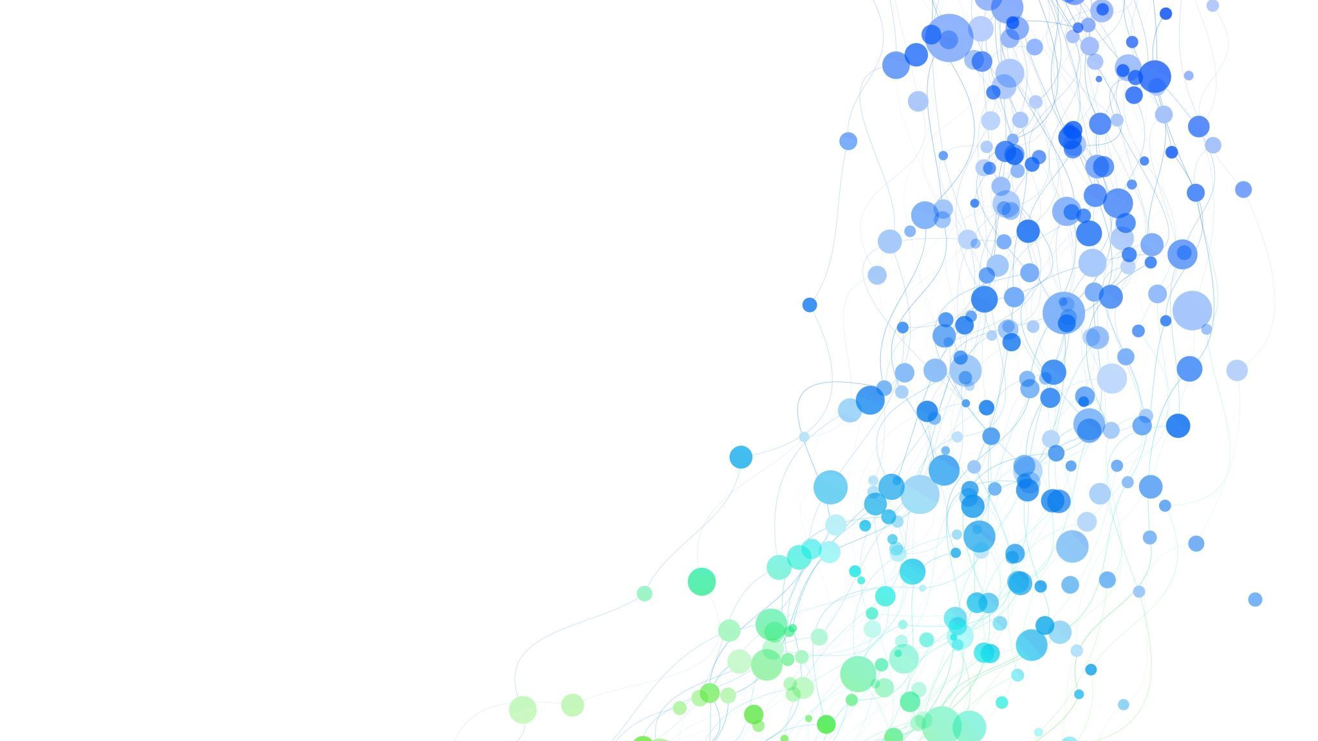
Analyzing Sentiments of Fine Food Reviews on Amazon
Tarani Rupa Neelapu
COMPSCI 715 Programming for ML

Slide 2




Table of Contents
Introduction
Methodology
Results and Evaluation
Conclusion
Future Work

Slide 3
Introduction
What?
Analyze customer sentiments on Amazon fine food reviews using VADER, Logistic Regression and DistilBERT Sentiment Model.
Why?
To understand customer feedback for product improvements
Performing sentiment analysis will help product owners understand customer satisfaction and dissatisfaction
How?
Use VADER Model.
Use Logistic Regression Model.
Use DistilBERT Sentiment Model.
Evaluate and compare the results by all three models.

Slide 4






Methodology
Step 1: Data Collection
Step 2: Data pre-processing
Step 3: Basic Exploratory Data Analysis
Step 4: Applying VADER Model
Step 5: Applying Logistic Regression Model
Step 6: Applying DistilBERT Sentiment Model
Step 7: Evaluating Results

Slide 5
VADER Model
VADER (Valence Aware Dictionary and sEntiment Reasoner) is a rule-based sentiment analysis tool specifically designed to analyze social media texts.
It is a pre-trained sentiment analysis model that provides sentiment scores for given text
VADER has 4 categories positive, negative, neutral and compound
Compound is a calculation of positive, negative and neutral score ranging between –1 to 1
VADER is easily available as a part of the NLTK (Natural Language Toolkit) library in python.

Slide 6
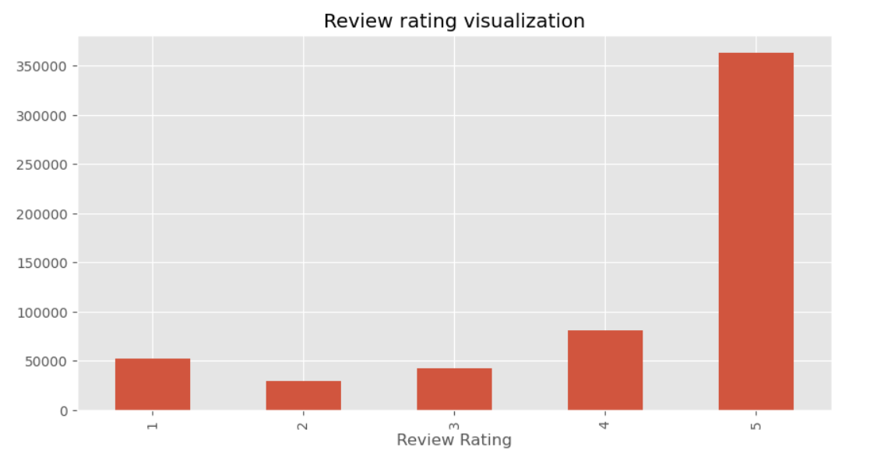
Results by VADER Sentiment Analysis
Figure 1: Exploratory Data Analysis

Slide 7
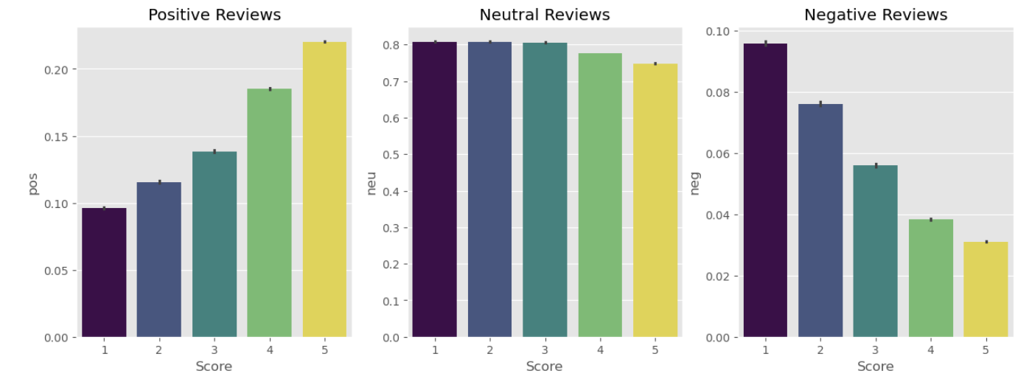
Results by VADER Sentiment Analysis
Figure 2: Customer Rating vs VADER Sentiment Score

Slide 8
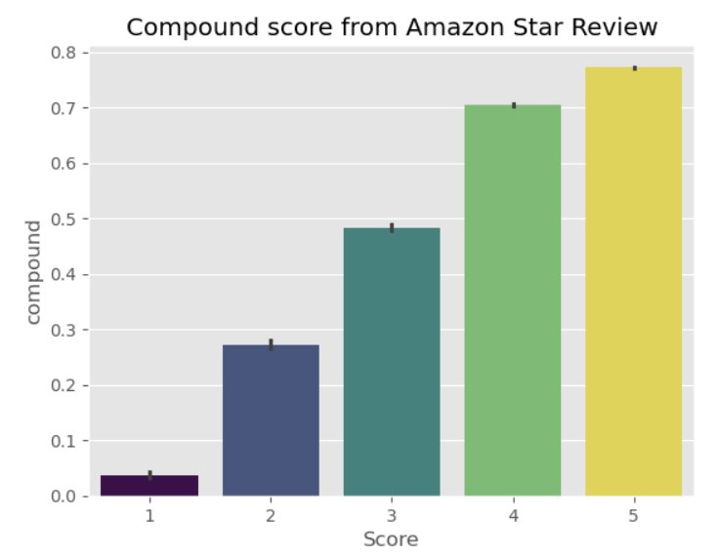
Results by VADER Sentiment Analysis
Figure 3: Customer Rating vs VADER Compound score

Slide 9
Logistic Regression Model for Sentiment Analysis
Logistic Regression is a supervised machine learning model used for classification.
Review text is first converted into numerical features using TF-IDF vectorization.
TF-IDF gives higher importance to words that are meaningful in a review but not too common across all reviews.
The model learns patterns between review text and sentiment labels.
In this project, ratings were converted into sentiment classes, and Logistic Regression was trained to predict whether a review is positive or negative.
It works as a strong baseline model because it is fast, interpretable, and performs well on text classification tasks.

Slide 10
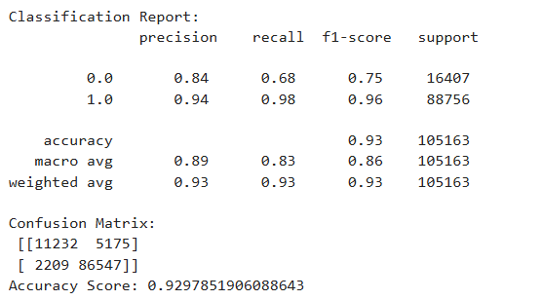
Results by Logistic Regression Model
Logistic Regression achieved approximately 93% accuracy on the test data.
The model performed very well on positive reviews, with high precision and recall.
However, negative reviews were harder to classify compared to positive reviews.
This may be due to the dataset containing higher positive reviews when compared to negative reviews.
Logistic Regression served as a strong baseline model before comparing with transformer-based BERT analysis.

Slide 11
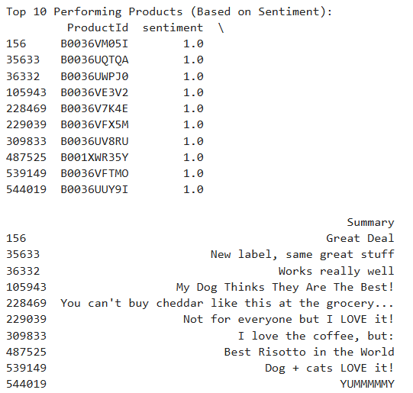
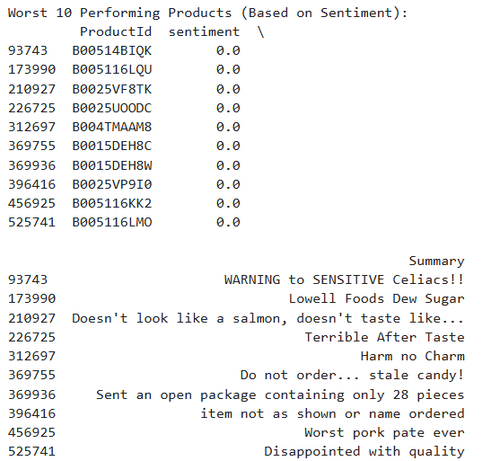
Top 10 Highest and Lowest Sentiment Products using Logistic Regression Model

Slide 12
BERT Sentiment Analyzer (DistilBERT sentiment model)
BERT is a transformer-based language model that understands the meaning of words based on context.
Unlike TF-IDF, BERT does not treat words as isolated tokens; it considers the full sentence structure.
A pretrained DistilBERT sentiment model was used to classify review text as positive or negative.
Since BERT was already trained on large text datasets, it was applied without fine-tuning due to CPU runtime limitations.
BERT provides both a sentiment label and a confidence score for each review.
This helps compare traditional sentiment methods with a modern transformer-based approach.
Note: Due to computational limitations DistilBERT was only applied on a sample dataset of 5000 rows.

Slide 13
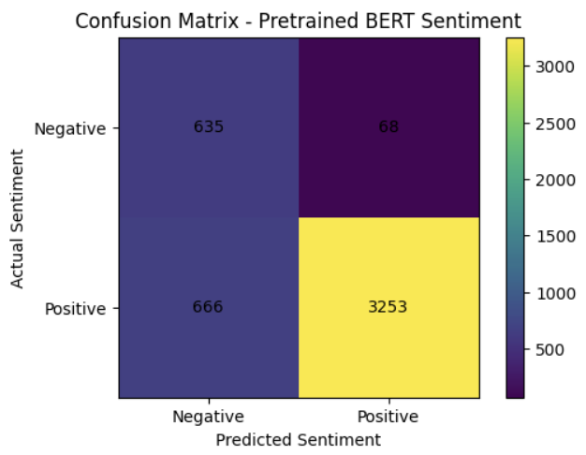
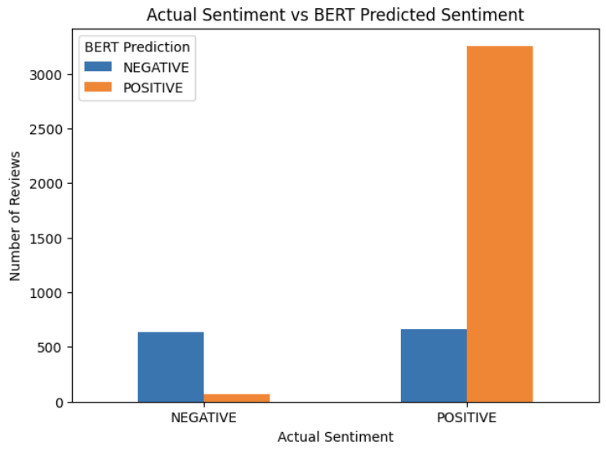
Results by DistilBERT sentiment model
Accuracy of DistilBERT Model: 0.8412
Evaluated rows: 4622
Positive F1-score: 0.90
Negative F1-score: 0.63
Correctly identified most negative reviews (635 of 703)
Confidence scores were highly concentrated near 1.0
Figure 4: Confusion Matrix, Actual vs Predicted sentiment scores

Slide 14

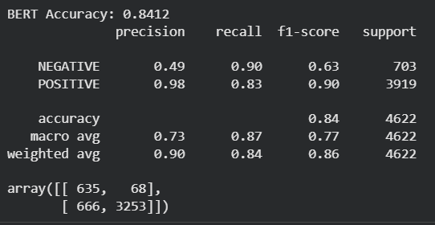
Results:
VADER Sentiment Analysis Accuracy:
Logistic Regression Analysis Accuracy:
DistilBERT Model Analysis Accuracy:

Slide 15
Conclusion and Future work
Which model performed better and what could be the reason?
How can this work be used in future for better sentiment analysis?

Slide 16
Thank you

